Slide 1
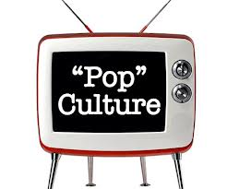
Introduction to & Definition of Pop Culture
Mr. Morgana
Room 305
Per 3

Slide 2
Let’s Get Our Brains Going…
Preamble
Look at the following 10 terms and do the following:
Give it a definition
How do you know what it means?
What role do these 10 terms play in your life?
Once you are done, switch papers with the person next to you and review each other’s definitions
“Google it”
YouTube Star
Memes
Snapchat Filters
Instagram
Memes

Slide 3
What this course is…
This is an elective class that helps to support the reading, speaking, & writing skills you’ll be developing this year for your life after Animo…
But…it’s also a cool, fun class that allows us to have intellectual conversations about some of the most entertaining aspects of our everyday lives…including…

Slide 4
What We Are Exploring…
We will be looking at course by quarters
What is Pop Culture?
Definition of Pop Culture
Pop Culture in Real Life
Compare and Contrast Differences in PC
Debrief and Reflecting on today’s session

Slide 5
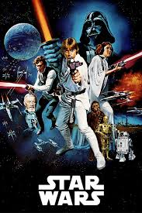
Pop Culture by Quarters
Quarter 1
Focus will be The Hero’s Journey
We’ll be using 3 films to analyze this concept
Star Wars: Episode IV A New Hope
Motorcycle Diaries
Hunger Games

Slide 6
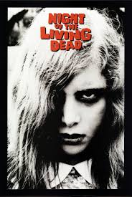
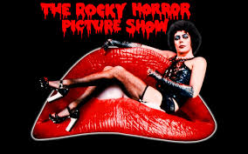
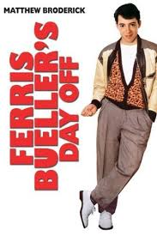
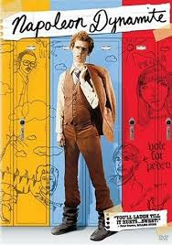
Pop Culture by Quarters
Quarter 1 Part 2
Focus will be Cult Films-What It means to be an outsider:
We’ll be using 4 films to analyze this concept
Night of the Living Dead
Rocky Horror Picture Show
Ferris Bueller’s Day Off
Napoleon Dynamite

Slide 7
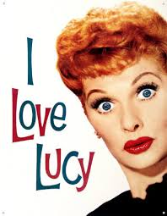
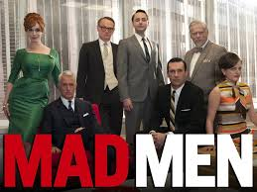
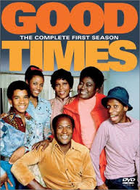
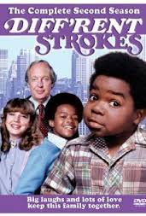
Pop Culture by Quarters
Quarter 2 Part 1
Focus will be Television Studies-race, class, & gender
We’ll be looking at TV shows from different decades including…
I love Lucy
Mad Men
Good Times
Different Strokes

Slide 8
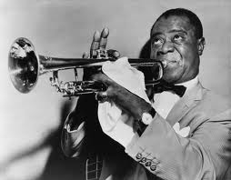
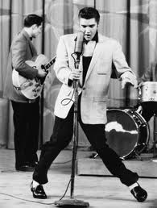
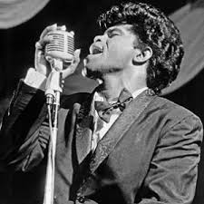
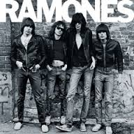
Pop Culture by Quarters
Quarter 3
Focus will be American Popular Music
We’ll be looking at how music in the U.S. has developed from 1890-Present- Some Genres:
First commercial music
American Jazz & Blues
Rock N Roll
Punk & Funk
Electronic Music

Slide 9
Pop Culture by Quarters
Quarter 4
Focus will be Social Media & Community
We’ll be looking at how social media has changed the way we interact with each other
Definitions of community
Influence of Social Media
In Depth look at Facebook
The Social Network film

Slide 10
Some Logistics To Know…
We have a course website that we use FOR EVERYTHING-
Here is the link- HINT YOU MAY WANT TO WRITE THIS DOWN
Animoleadershippopcult.weebly.com
Pop Culture Website

Slide 11
Taking a Look at What Pop Culture Can Look Like…
You’ll be watching series of videos- for each video do the following:
What do you know about what is being shown?
How do you know what it is? If you don’t know, why don’t you know?
Mona Lisa
The Simpsons on FXX
P90X3

Slide 12
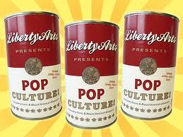
What is Pop Culture?
Here’s the fancy definition from somewhere legitimate: Popular Culture is the arts, artifacts, entertainment, fads, beliefs and values that are shared by large segments of society.

Slide 13
Working in Pairs…Some Thinking
On a sheet of scratch paper, make a list of objects, individuals and attitudes that are considered Pop Culture: (i.e. TV, music, slang, activities, etc)
Now, select one student to go up to board and put down some of these items on the board

Slide 14
Defining Pop Culture Terms

Slide 15
Starting to define Pop Cult…
Items on Board
Questions:
Take a look at all items on board, take 5 mins to reflect on this question(s) (you may write this in your notebook):
How do we have access to all these items?
What happens when a person doesn’t know what these items mean?
Are any of these items important in our lives? Why or why not?

Slide 16
What is Pop Culture?
AGAIN, Here’s the fancy definition from somewhere legitimate: Popular Culture is the arts, artifacts, entertainment, fads, beliefs and values that are shared by large segments of society.

Slide 17
Pop Culture in Real Life
Take a look at the following clip and write down anything that you notice about what is being presented…
Japanese Human Tetris
Take 1 min each, in your pairs to share with each other your observations…
Bringing this out to the floor…

Slide 18
Pop Culture in Real Life
Same as the previous clip, write down anything you notice about the clip…
SNL Black Jeopardy
Take 1 min each, in your pairs to share with each other your observations…
Bringing this out to the floor…

Slide 19
Comparing Pop Culture
Now that you’ve seen two different examples of pop culture…
With your partner, try and work out how they are similar and different…
You’re going to use a simple tool…
A Venn diagram…here is an example

Slide 20
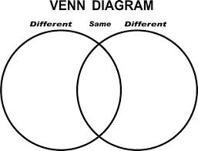
Venn Diagram Comparison
Japanese Show
SNL Black Jeopardy

Slide 21
Last Debrief for the day…
Take 1 min with your partner to take a closer look at what you wrote…
Choose 1 difference and 1 similarity you’d like to bring out
Bringing these out to the floor…

Slide 22
Wrapping Session 1 Up
QUESTIONS SO FAR?
Take 1 min to think about how your idea or concept of Pop Culture has changed after this first session
I will have everyone share for 15-20 seconds
Next session, we will be looking at the Conditions or criteria for something to be labeled Pop Culture

